Slide 1
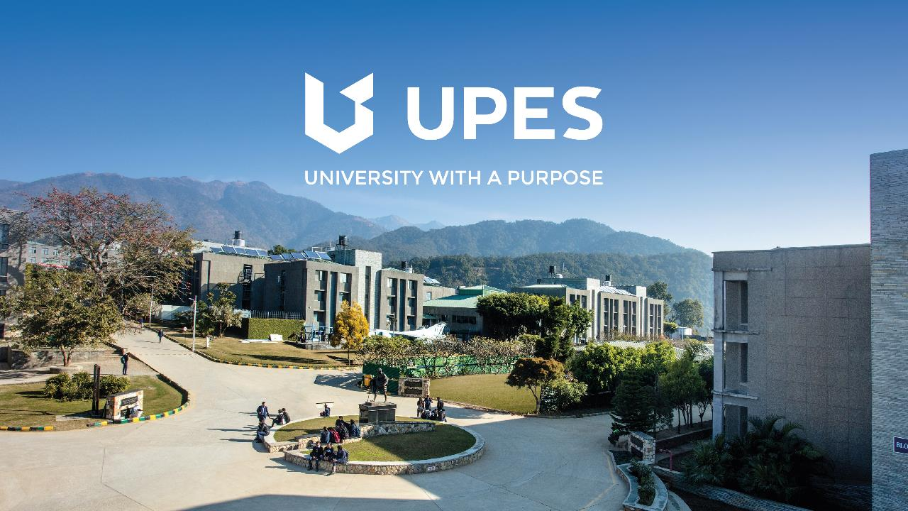

Slide 2
Image reading and handling

Slide 3
Our Objectives
Primary - create a library for c++ to access an image’s data and process it, allowing operations to be performed over the image data.
Secondary - To create image transformation tools (filters) on top of our library in C++ , that demonstrate some of the use cases of the library.

Slide 4
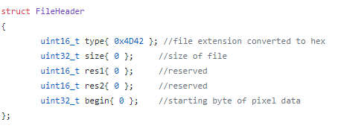
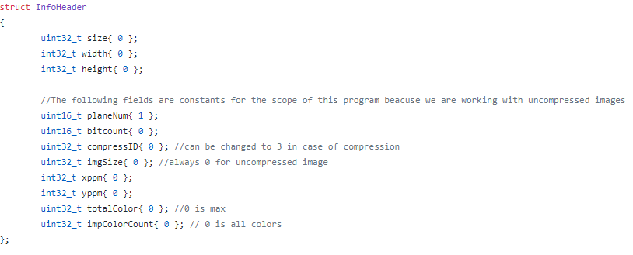
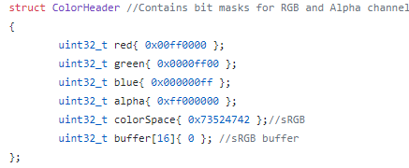
Image Reader
How does it work?
Images have a header that can be stored in a character array.
BMP images use no compression.
The given character array is then stored in structs in c++ to become meaningful.
Information such as pixel data , color data etc. are stored along with macro information such as colorspace
Operations are performed on a vector(imgData) that acts as a color table to be displayed.

Slide 5
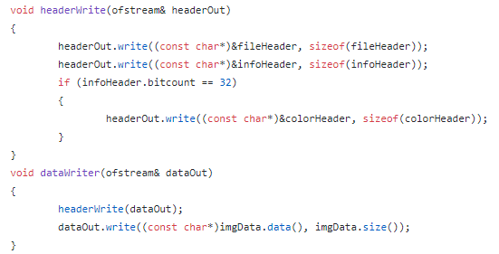
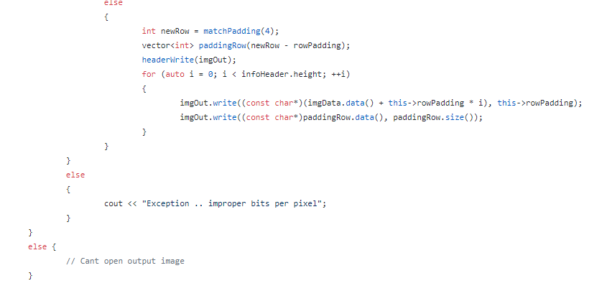
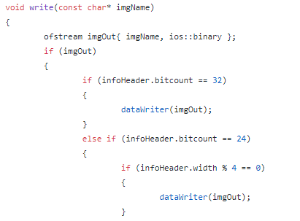
Image Writer
How does it work?
Takes the updated imgData vector , color header, file header, info header.
Takes into account the number of bits per row and number of 0s to be padded
Writes these into a file in the required order , keeping appropriate characters at their places.
Checks if the written file is a valid BMP
Writes the file to disk

Slide 6
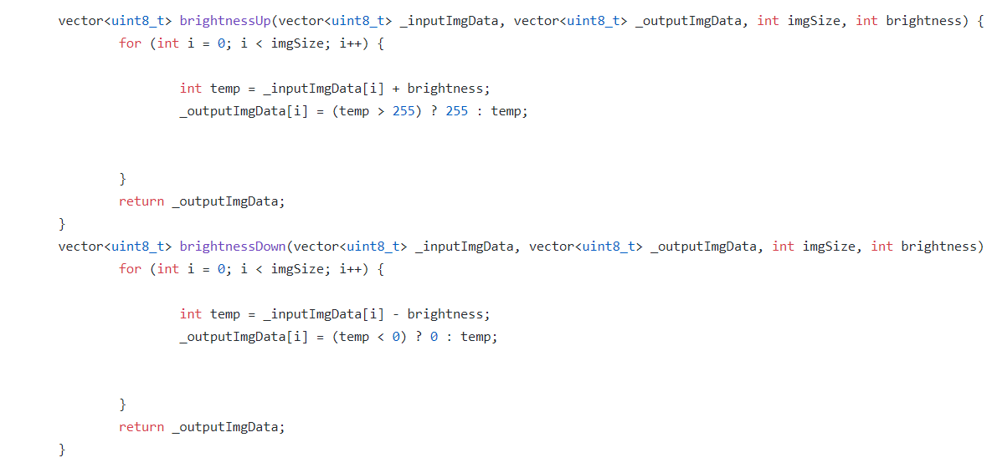
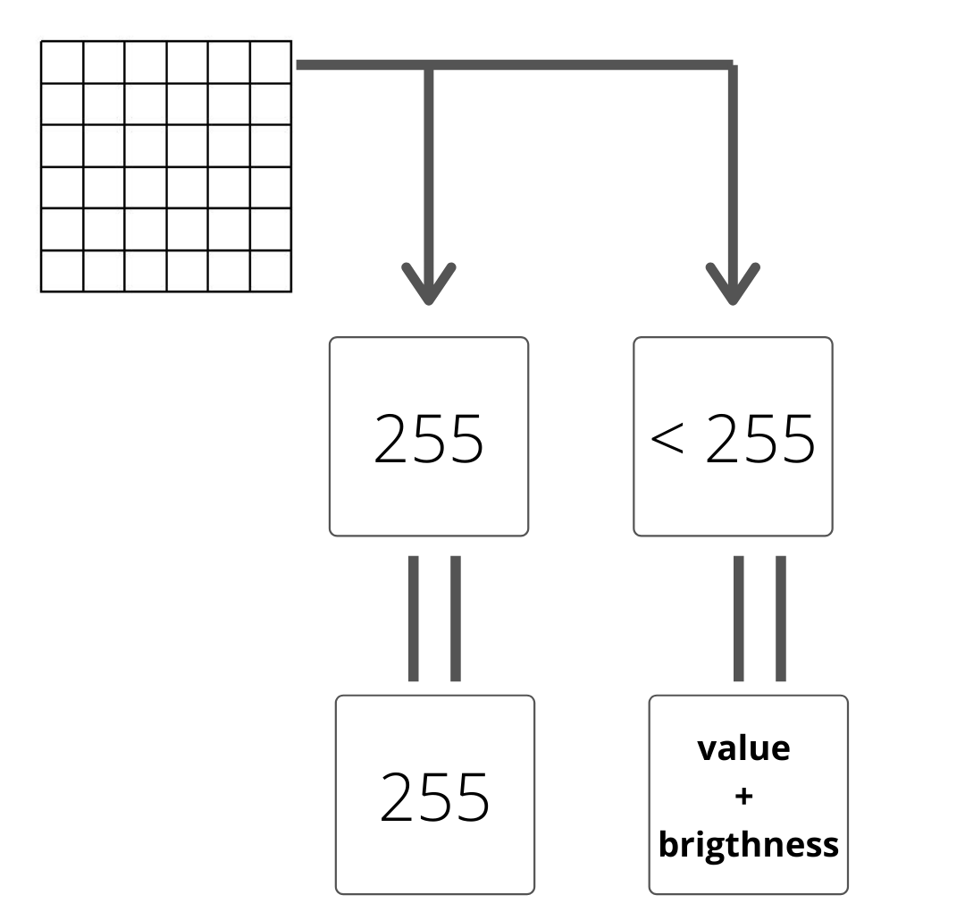
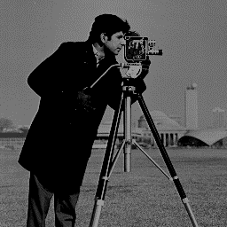
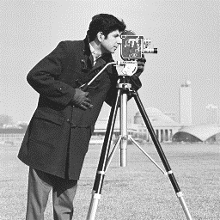
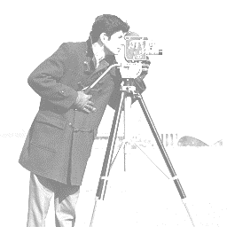
Filters
Brightness

Slide 7
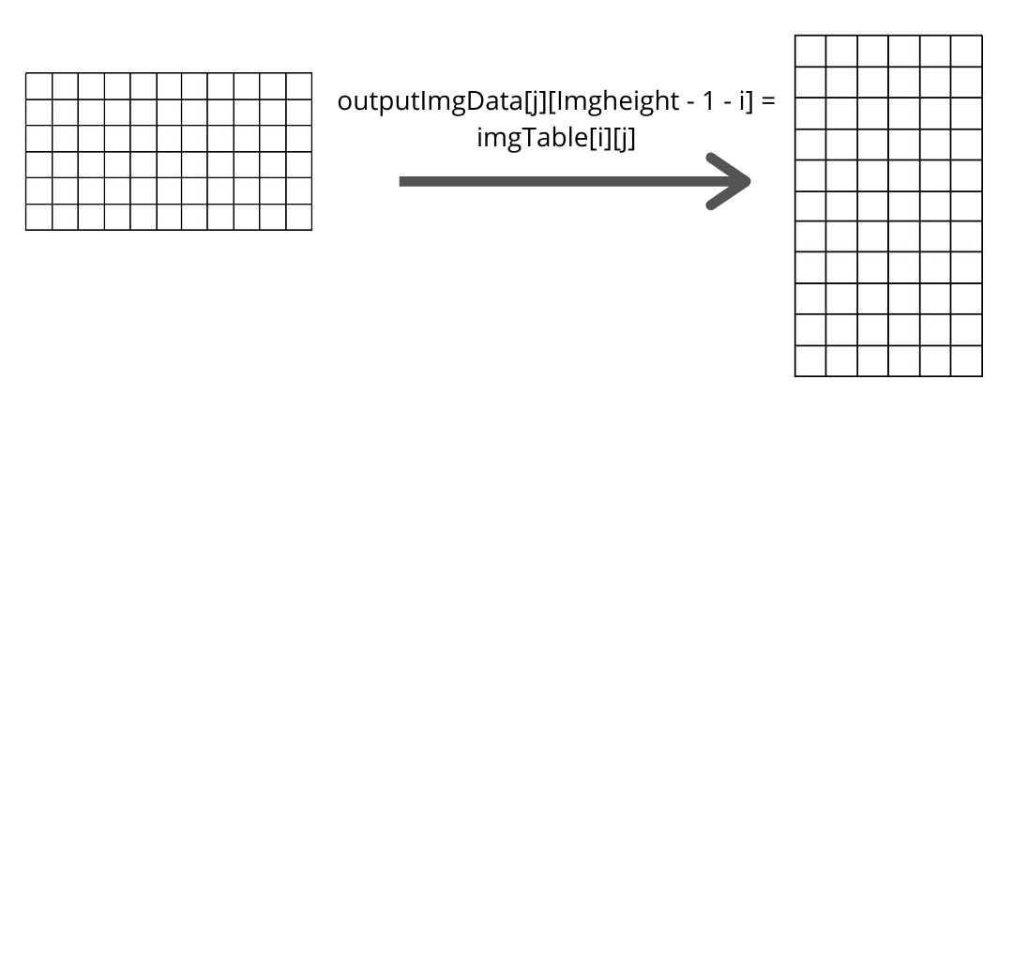
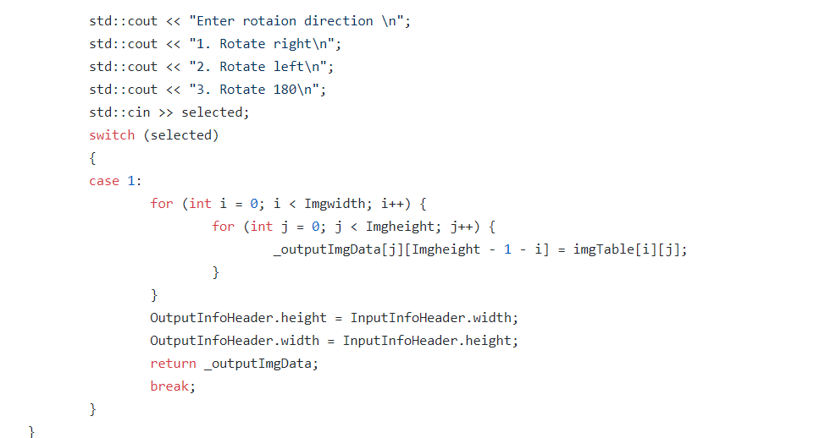
Filters
Rotation

Slide 8
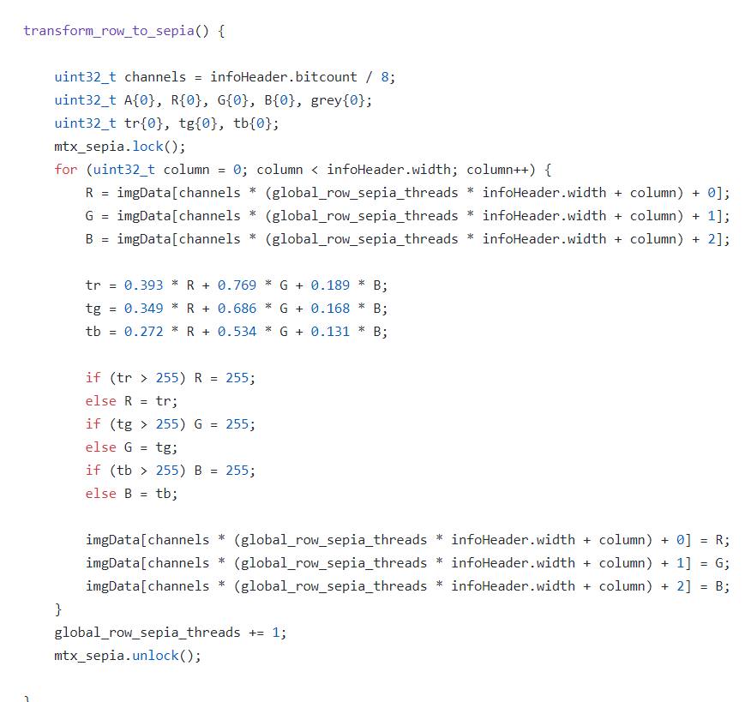
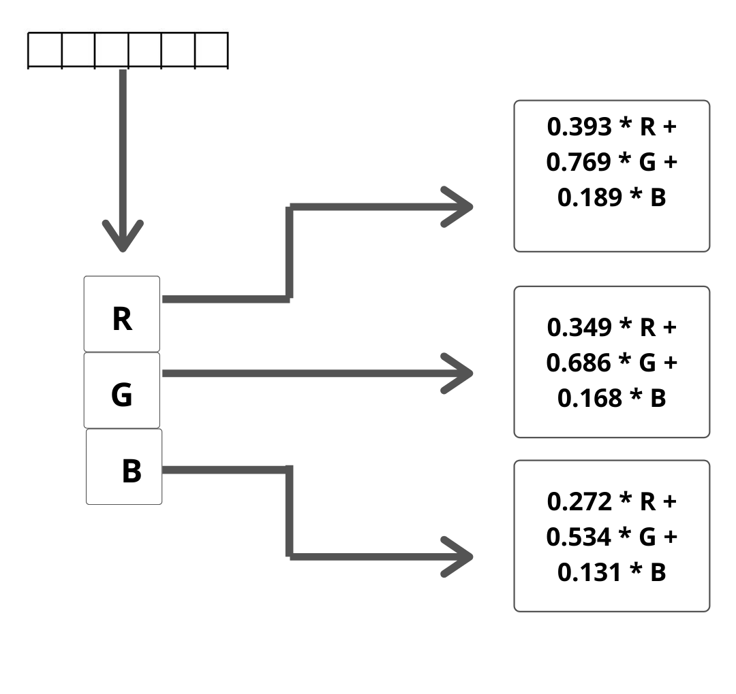
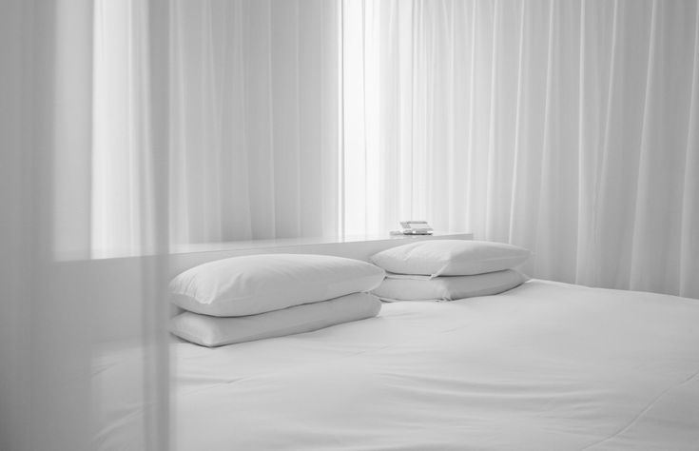
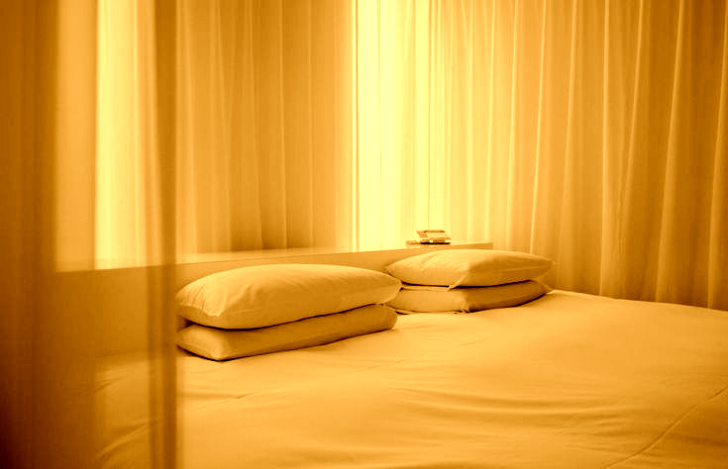
Filters
Sepia

Slide 9
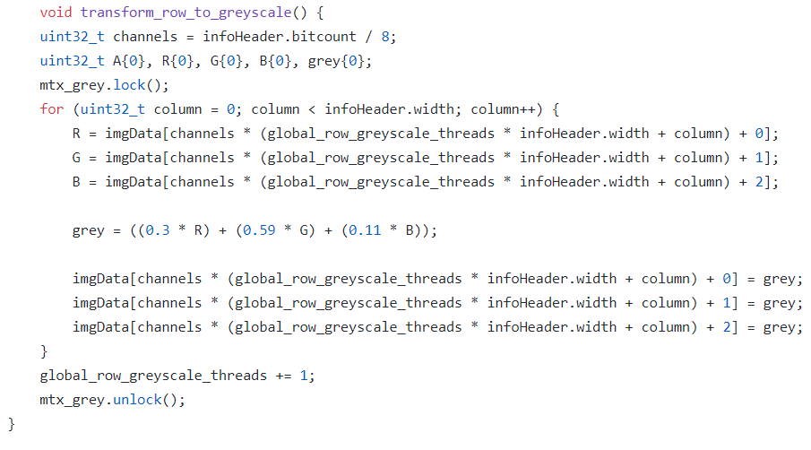
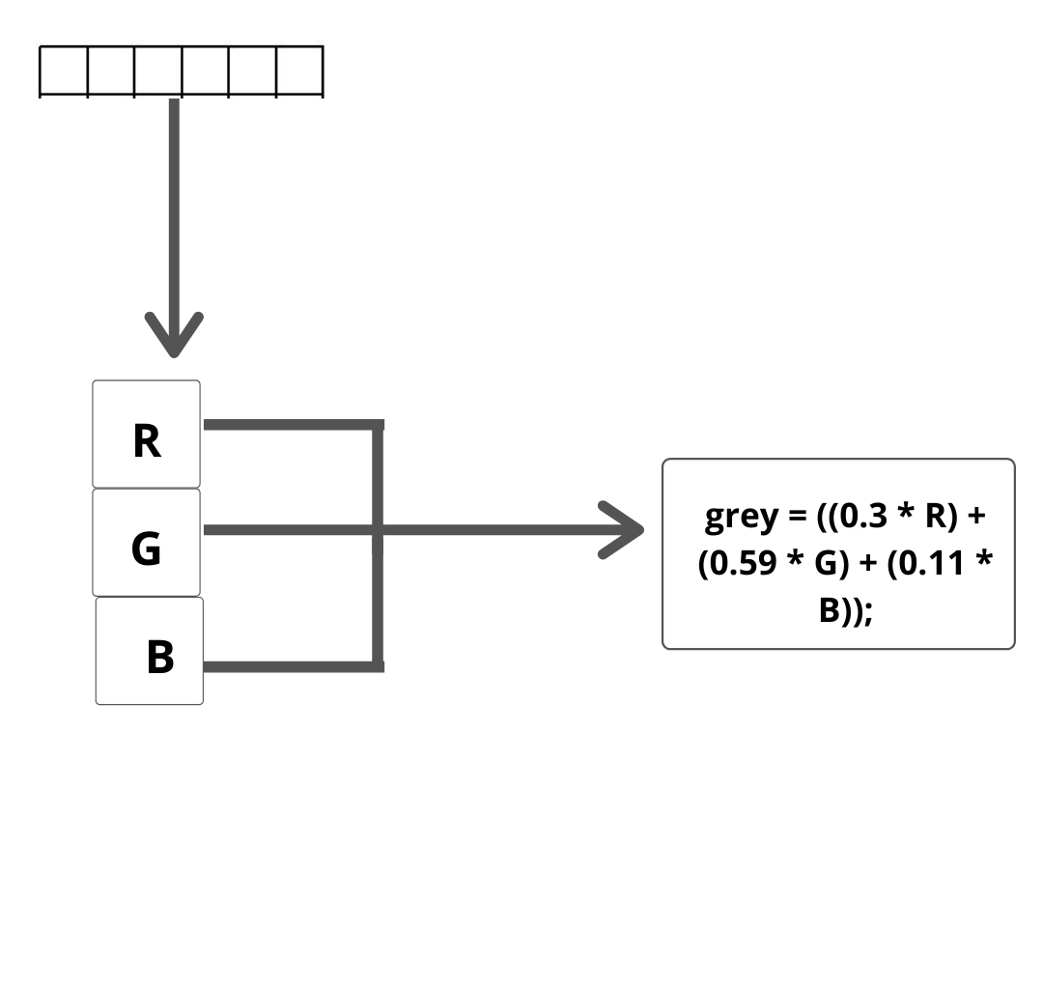
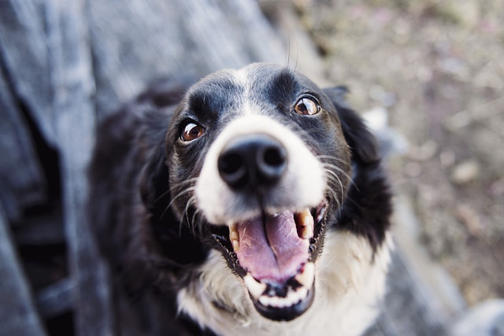
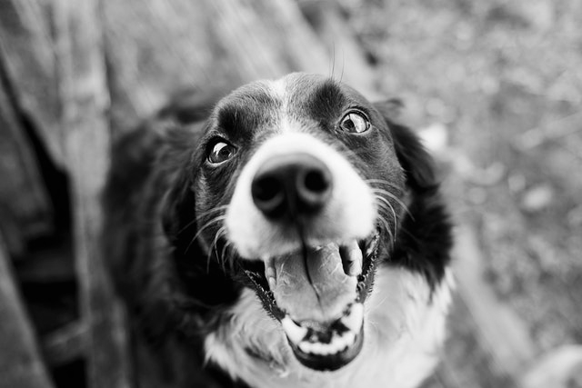
Filters
Grayscale

Slide 10
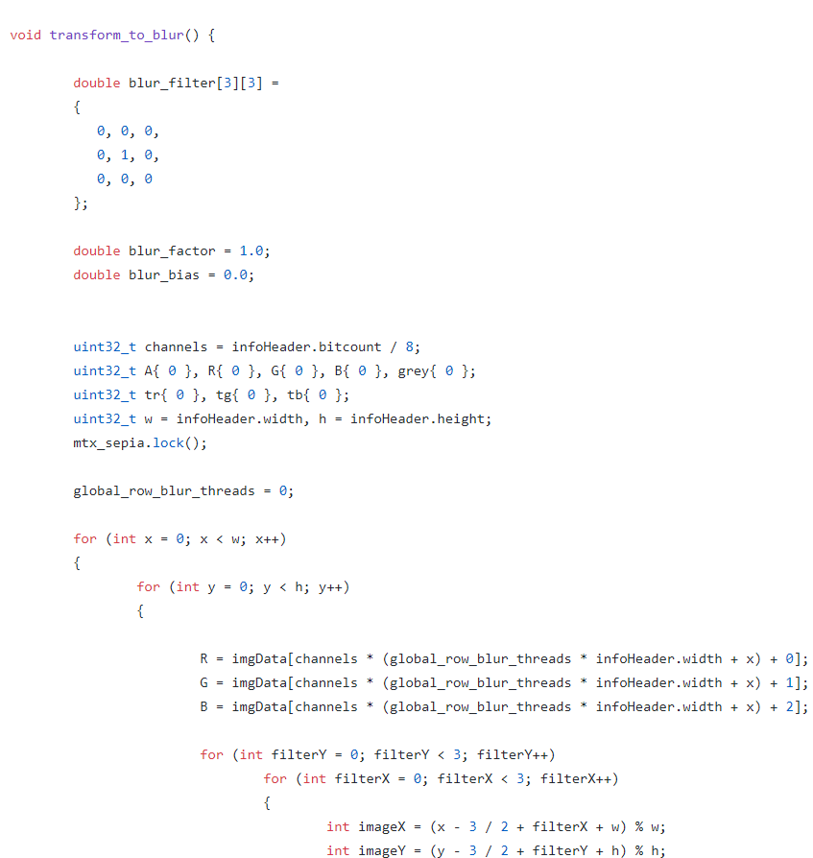
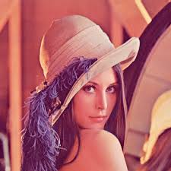
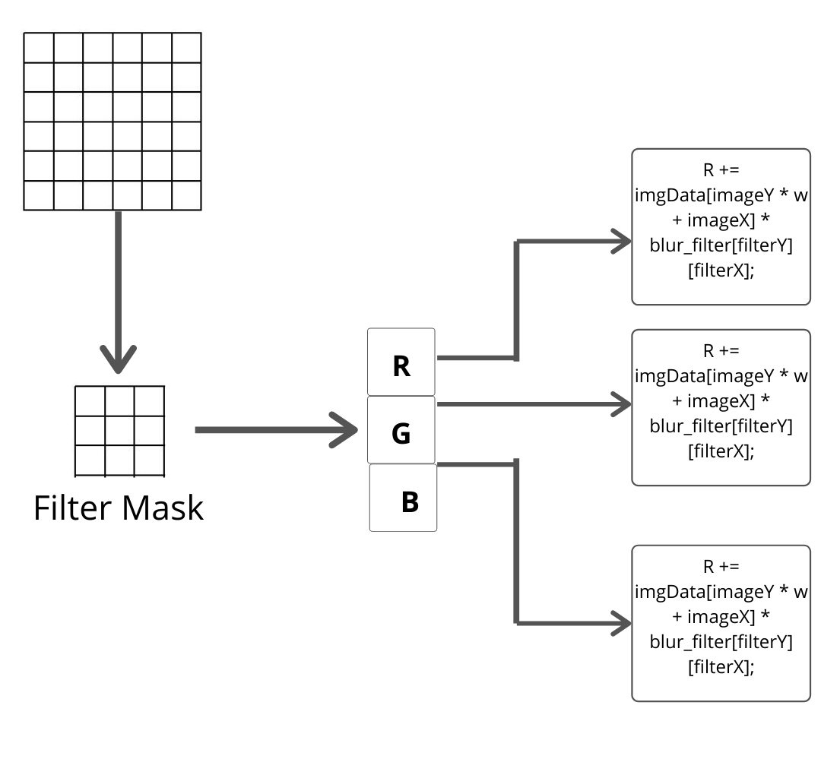
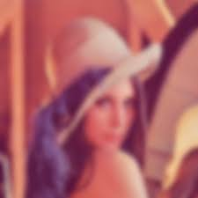
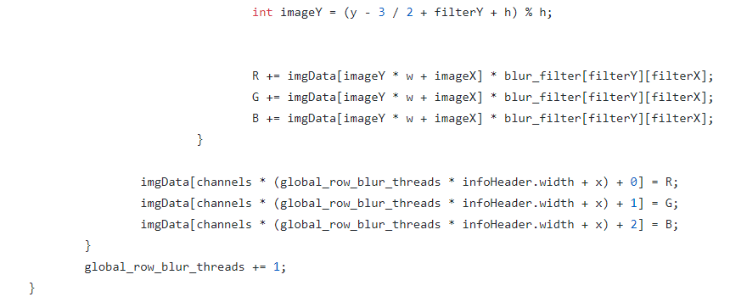
Filters
Blur

Slide 11
THANK YOU

